Slide 1
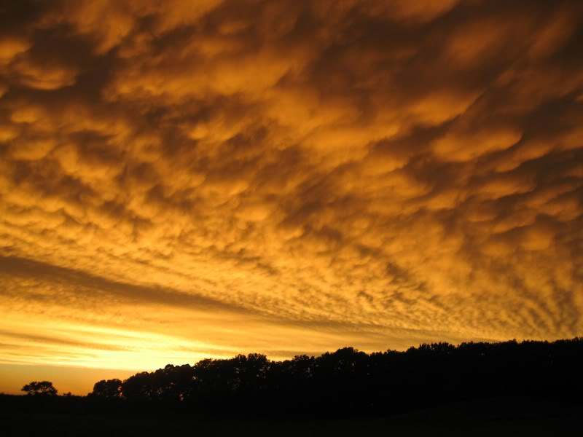
The Line and the Light
Photos by Scott King
Poetry by Becky Norman

Slide 2
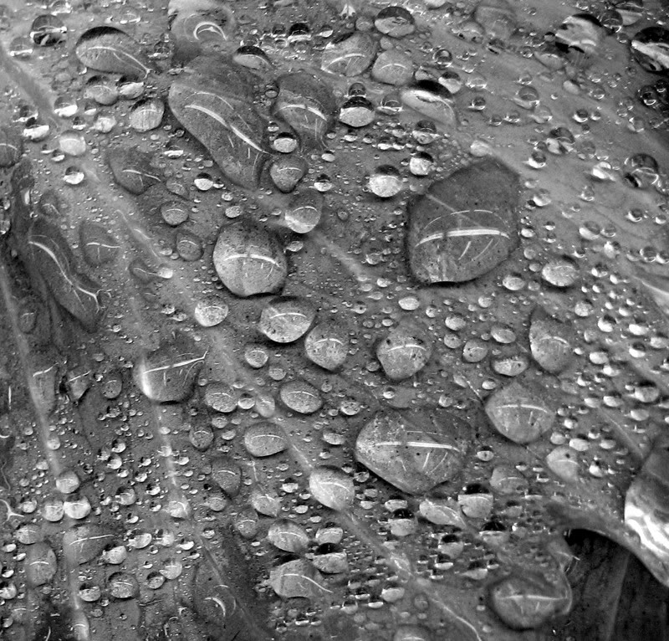
Surface Tension
The strength it takes for water
To cling to leaf is magnificent.
One fingertip, pressed to the surface –
One casual brush of a hand as it
Sweeps the branch aside –
And all is shattered.
Droplets scatter across
Rain-soaked grass or
Douse hunch-shouldered heads,
Exclaiming in surprise at the cold
And the wet.
Those that remain, reform.
Gather up and become globules again.
Hold on, for all they’re worth.
Until the next disturbance.
Or until the sun is high.

Slide 3
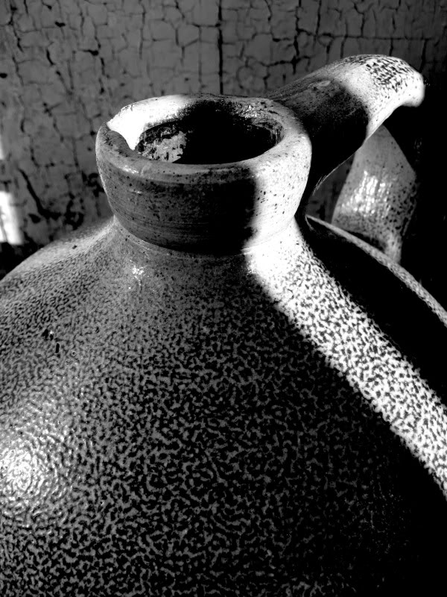
Jug
We’d pile into a car and go driving –
Hunting for treasures
At auction houses, antique stores,
Country markets.
Each of us searching for memories
Of what our childhoods were:
Simple days; unspoken and
Profound family love;
Unending summer play when,
Hot and sweaty,
We’d tear across the lawn with
Croquet mallet or golf club in hand.
We’d sit on coarse concrete steps
And drink lemonade.
Or pile into canvas hammocks
To press our faces into watermelon.
Textures of metal, stone and wood
Under our fingertips.
Not plastic.
We search for the natural in our middle age.
And amongst those souvenirs (reminders)
There’d be the odd piece –
So ugly it was beautiful,
So out-of-date it was memorable.
Sad irons and Christmas candles and broken jugs,
To tease each other, to joke about...
To create more memories.

Slide 4
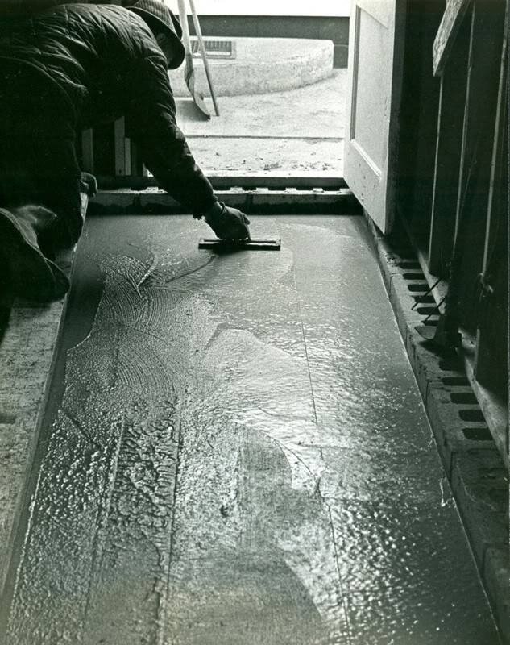
Precision
Another art form, this:
Sourcing suitable ingredients,
Blending them correctly,
Mixing the right amount of time.
Then that small window of opportunity to pour.
Two brothers at the mixer,
Shovelling sand, coarse gravel,
Adding cement and water from the hose.
You had to know what you were doing.
And “the old man” ready for the wheelbarrow,
His screed board nearby
And float in hand.
Not too much at once,
Not too much of a delay between loads.
Then working, working, working.
Smooth the surface, tip the edge of the tool.
When it was hardened, finished,
Others would walk on it,
Not realizing the teamwork it took
Or the precision beneath their steps.

Slide 5
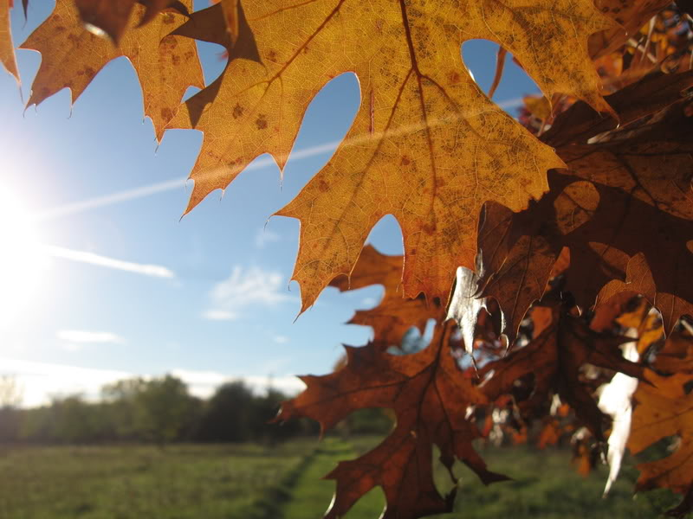
Speared by Sun
It’s getting on to fall
And you can feel the earth is weary.
Enough, already – with the growing
And the greening and the looking after young.
It’s time to turn toward winter,
When the wind roars cold and eerie.
And so living things draw into themselves,
Leaves let loose from whence they hung.
The days begin to shrink, the dimming of the light
Begins to leave us ponderous and dreary,
The harvest reaps enough to get us through –
The apple cider rolls with tartness on the tongue.
It seems as though it all is fading,
But hold, for that one final, glorious query,
When summer’s light breaks through in splendor
And those final leaves are speared by sun.

Slide 6
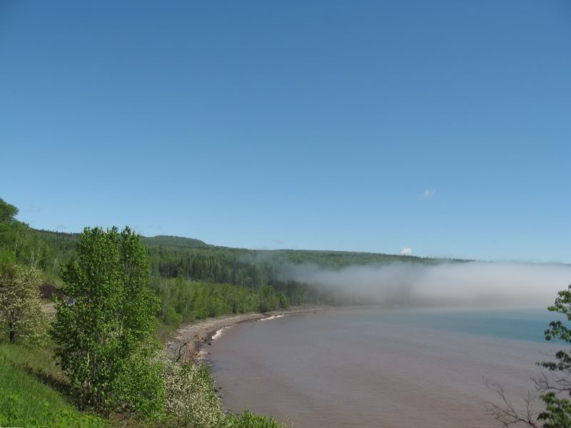
Creeping
Strange how you can stand
In sunlight, high atop some
Rocky knoll
And watch the mist
Come creeping,
Knowing all the while
That if you were down there –
In it –
You would feel hemmed in,
Invaded, helpless,
Claustrophobic.
Strange how perspective
Can change things.

Slide 7
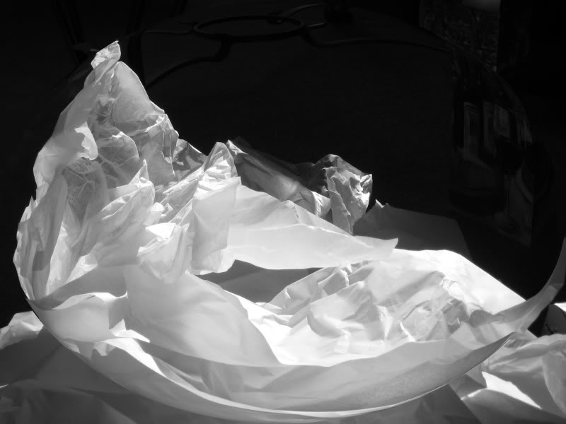
Crumpled
Things used to be smooth.
Everyone starts out with a blank canvas,
One flat, long line of potential.
Then the clock starts ticking.
Things happen.
Hands might grip a little too harshly,
You get exposed to the elements,
You might even get torn.
Things get roughed up.
You curl away from what hurts
Or deaden yourself to the pain,
Grow a thicker skin.
But things turn out okay.
All those scars and wrinkles,
All those ways experience molds you,
They make you beautiful.
You can’t catch the light
Unless you’re crumpled.

Slide 8
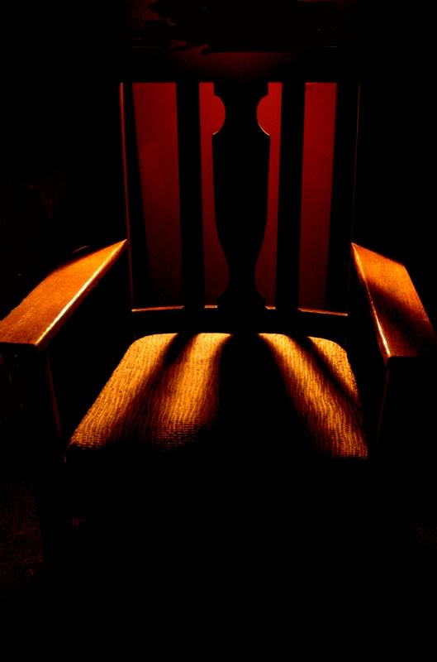
Rocker
Women understand the importance of chairs.
Without them, laps are lacking,
And the soothing seesaw motion
To lull sleepy heads into their dreams.
Grandmothers feed bottles,
Sisters tell stories, and
Aunts share ice cream while
Baby-fat cheeks get coated in chocolate.
Too wide a rung and heads might get stuck,
But if it’s built well, children will clamber
Onto seats, backs and arms like monkeys
Returning to their favorite trees.
Women understand the hearts of the home:
A kitchen, pulsating laughter and warmth
And provender for body and soul;
And the organic rhythm of the rocking chair.

Slide 9
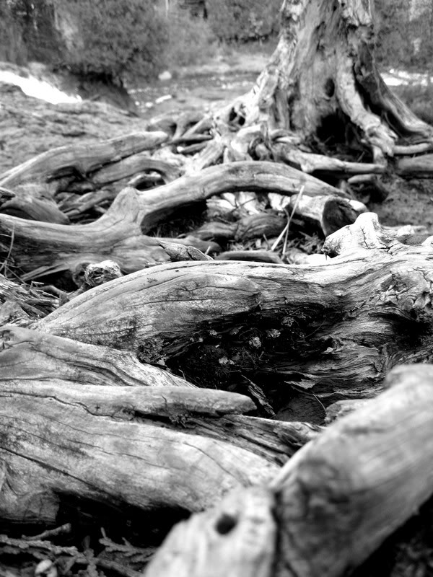
Roots
(for Maggie)
What is visible to the eye is pleasing
But the trunk and leaves are just a teasing
Of all the strength that’s down below
It’s the roots of the tree that help it grow.
When wind and rain begins to whip
And branches bow with steady drip;
When the soil erodes upon the hill,
The roots of the tree will hold it still.
To watch a child in similar fashion
Has become a type of quiet passion –
While her own beauty is refined
It’s the roots of her family there, defined.
When the storms of her life pass overhead
And blood and many a tear are shed,
She’ll remain strong, fixed to her place;
With the roots of her family there at the base.

